Slide 1
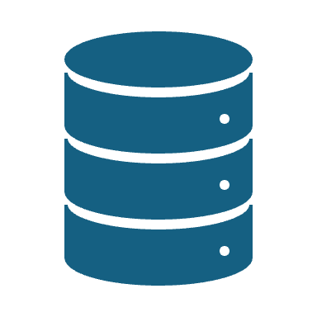
Introduction to Aurora Cluster
Introduction to Aurora cluster
Aurora cluster design basics
Aurora cluster in a single region
Aurore cluster in multi region (Global database)
JPMC Commercial Card Standard deployment
Aurora write and read paths (Time permits)
Internal of write and read paths
New improvements

Slide 2

Aurora Cluster
Cloud-Native Distributed Architecture: separates compute and storage
Full Compatibility with MySQL & PostgreSQL: Aurora is wire-compatible with both MySQL and PostgreSQL.
core principle of Aurora's design is that "the log is the database.”
Supports Multi-AZ and Global cluster(Multi-region)
Seamless Read Scalability with Replicas

Slide 3
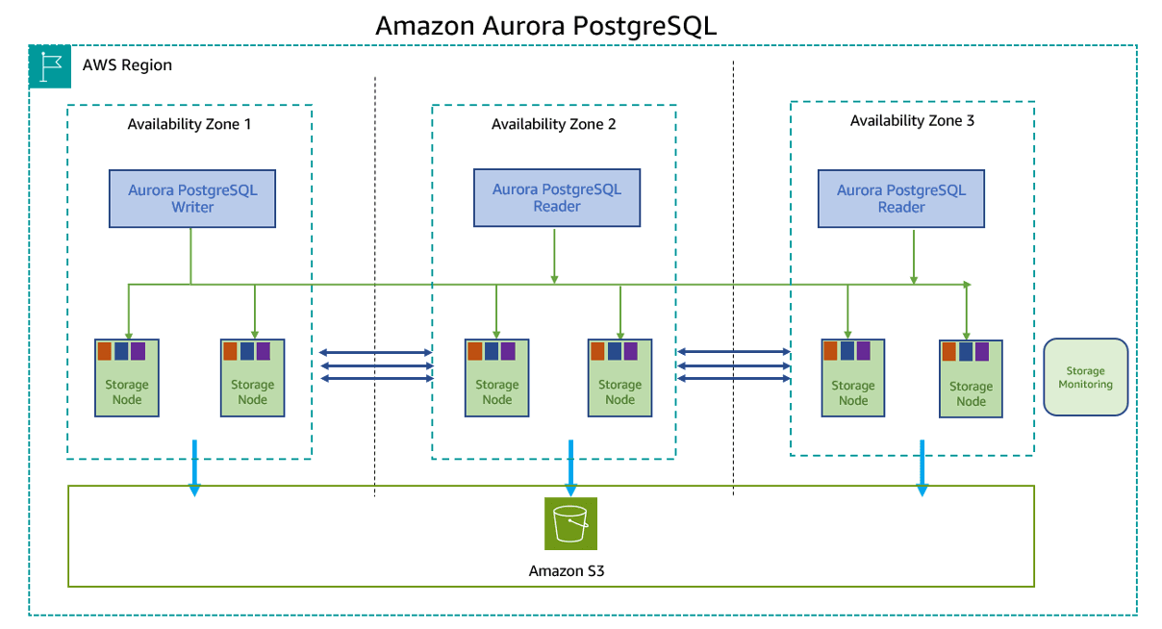

Slide 4
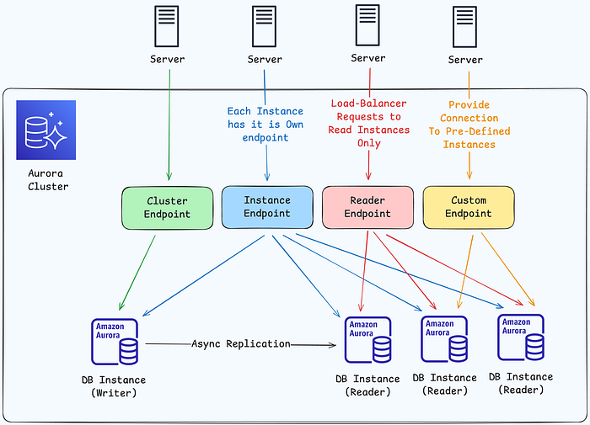

Slide 5
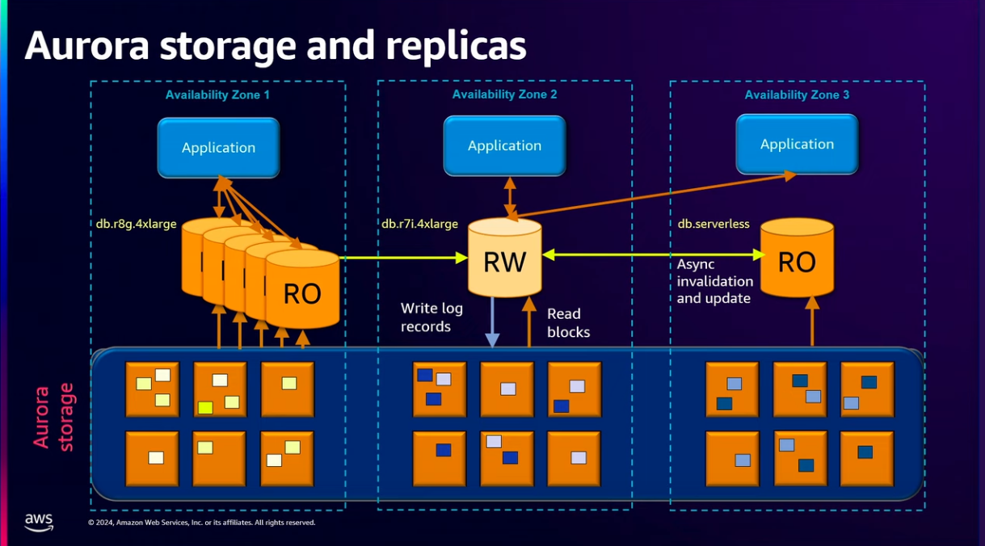

Slide 6
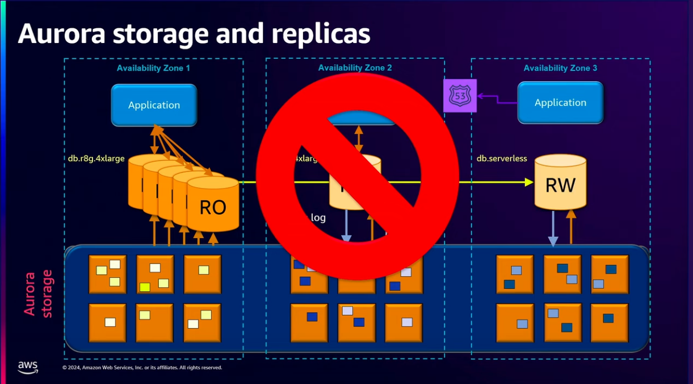

Slide 7
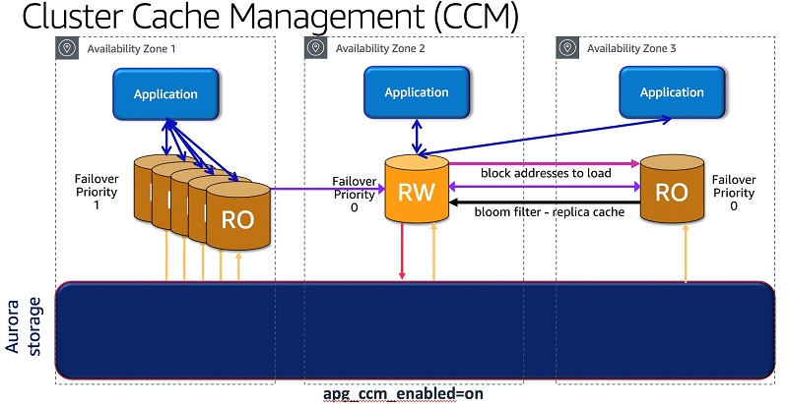

Slide 8
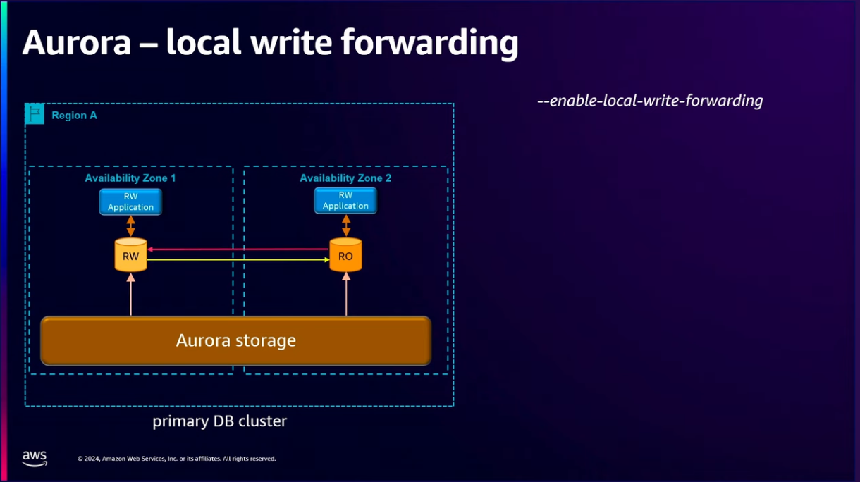

Slide 9
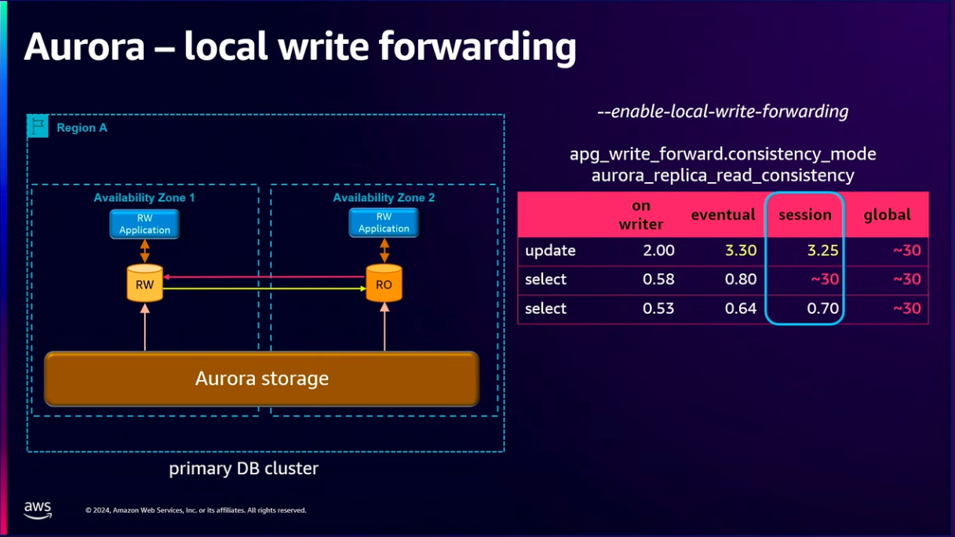

Slide 10
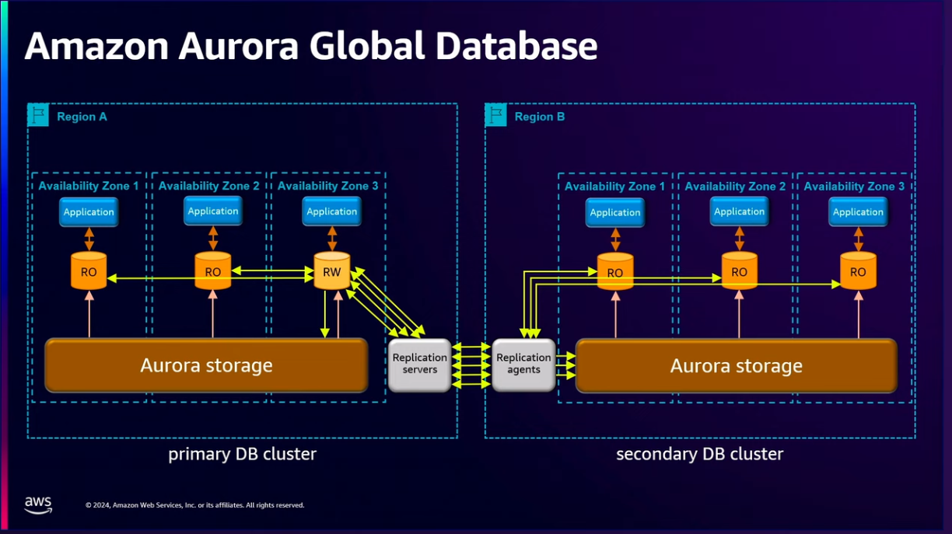

Slide 11
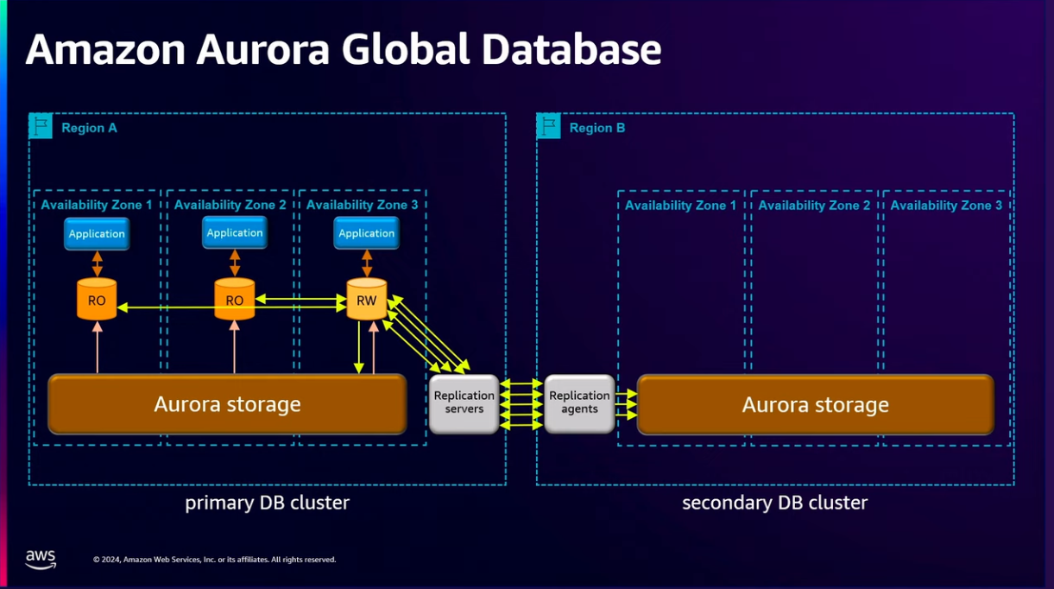

Slide 12
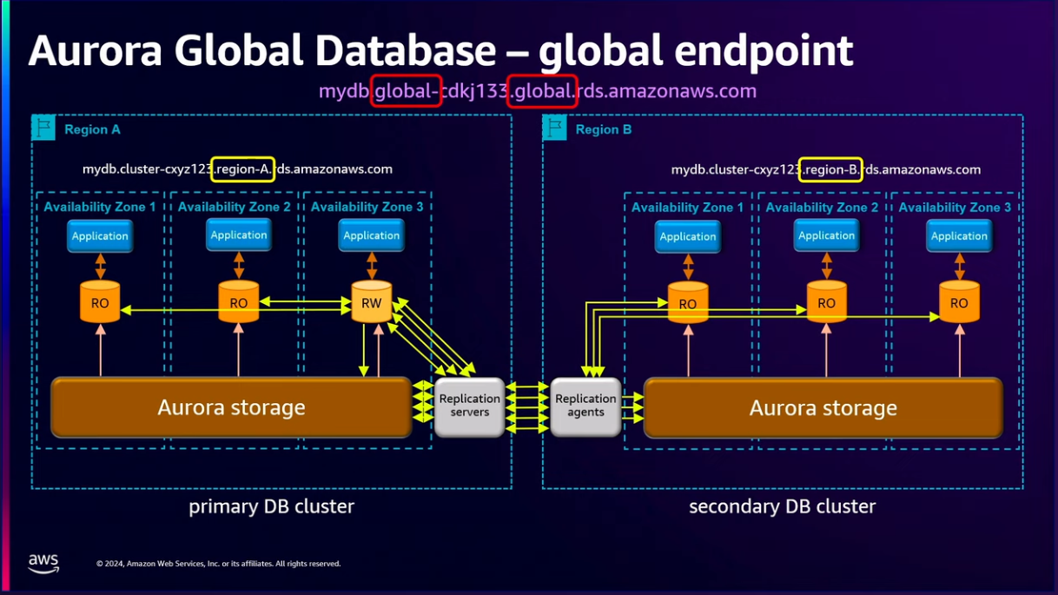

Slide 13
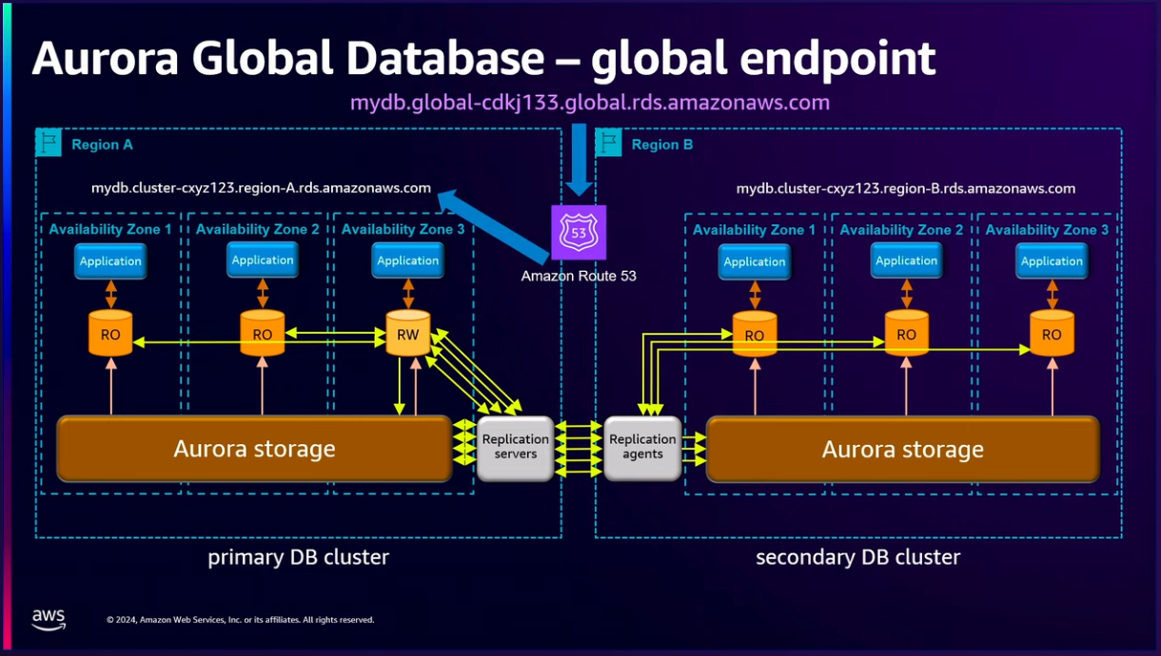

Slide 14
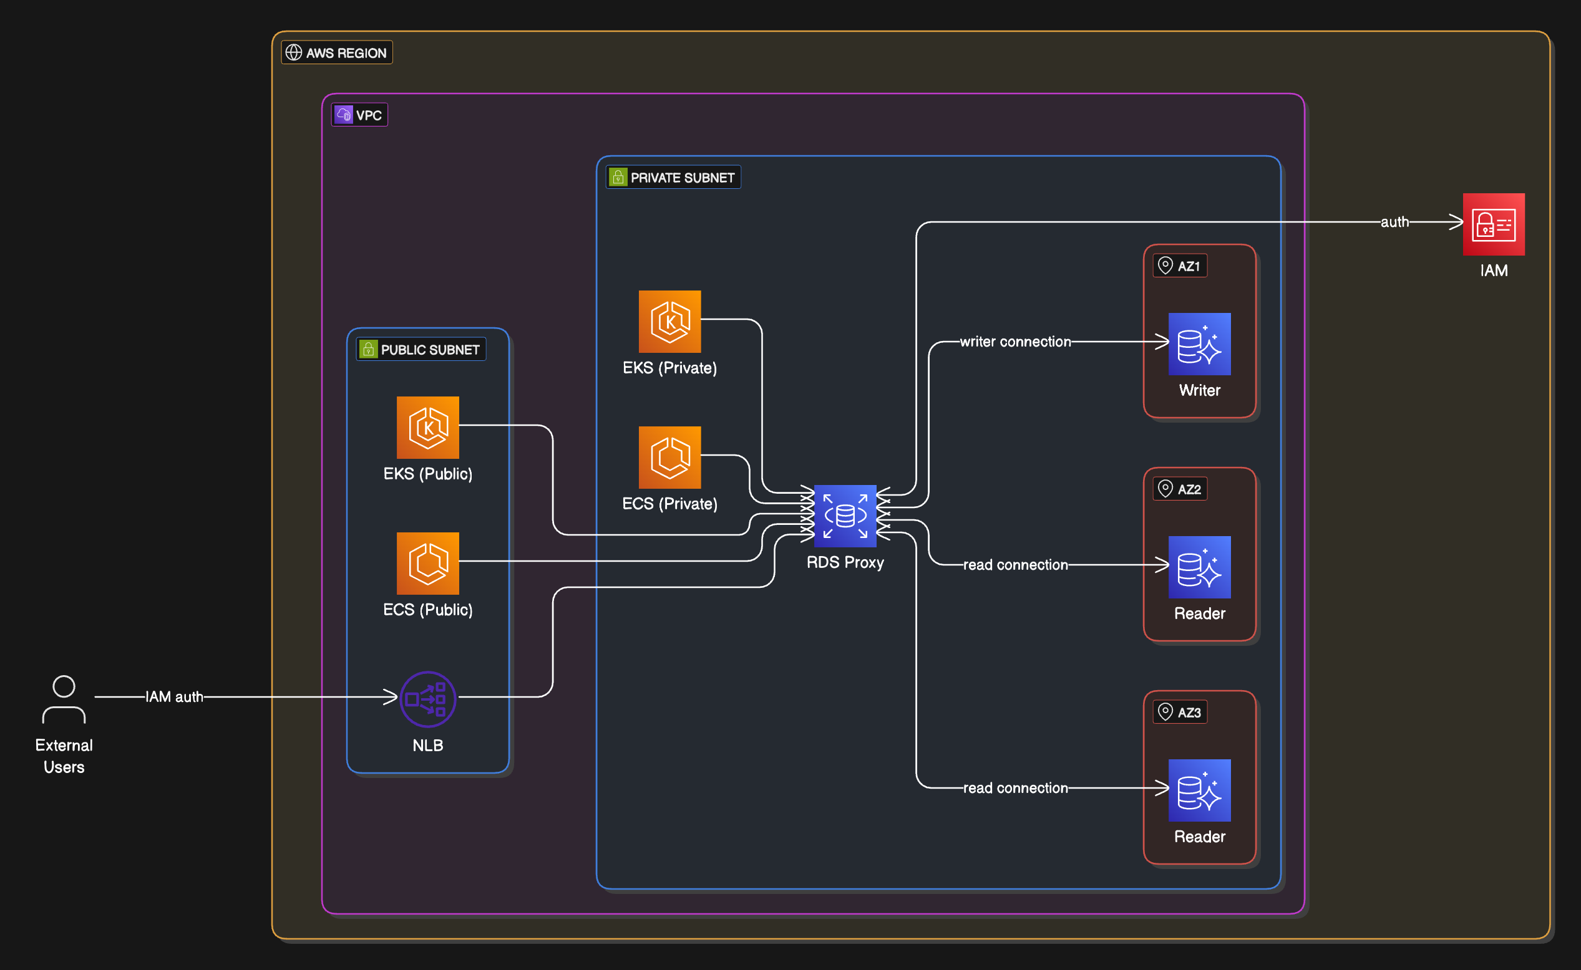

Slide 15
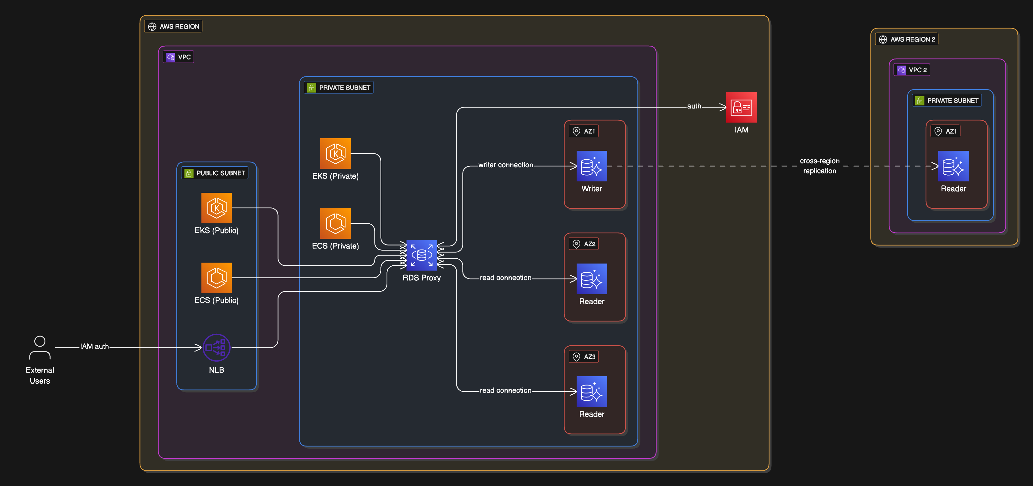

Slide 16
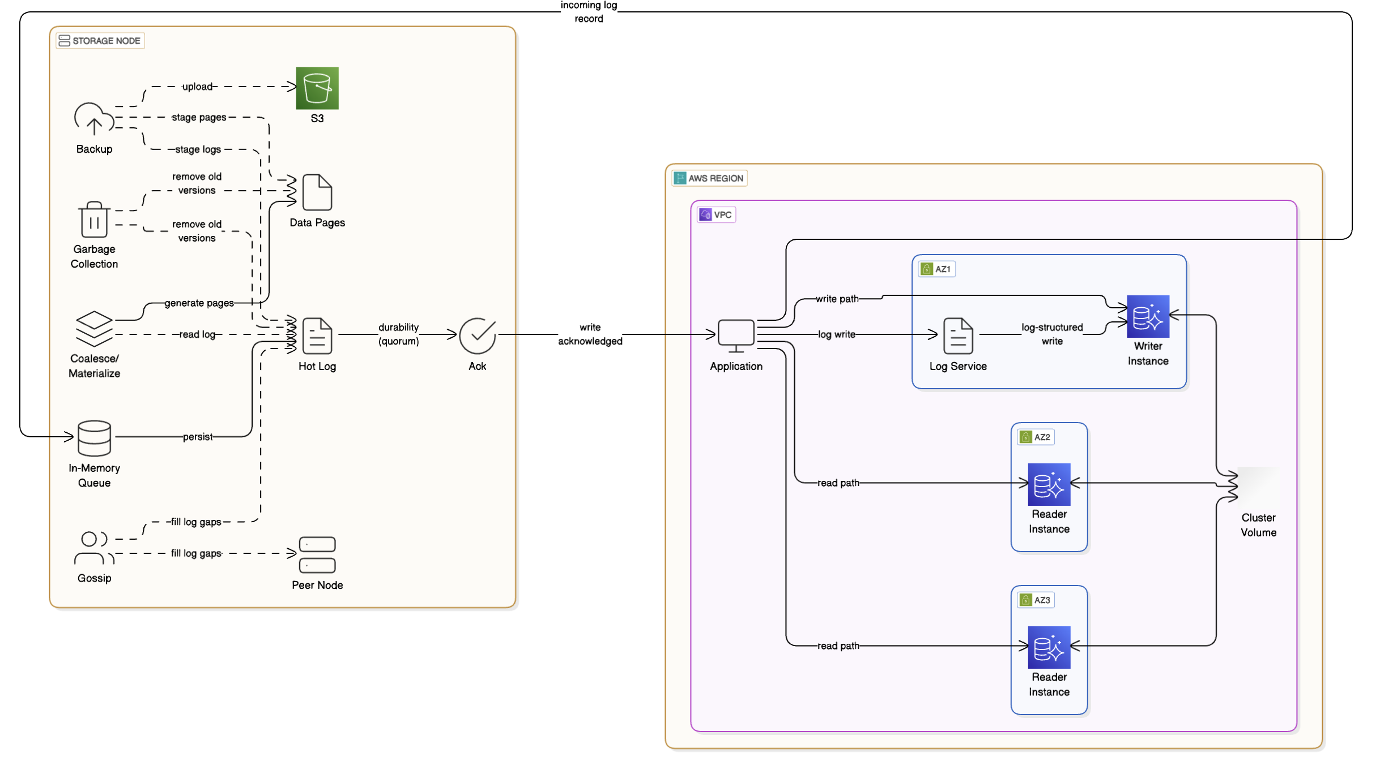

Slide 17
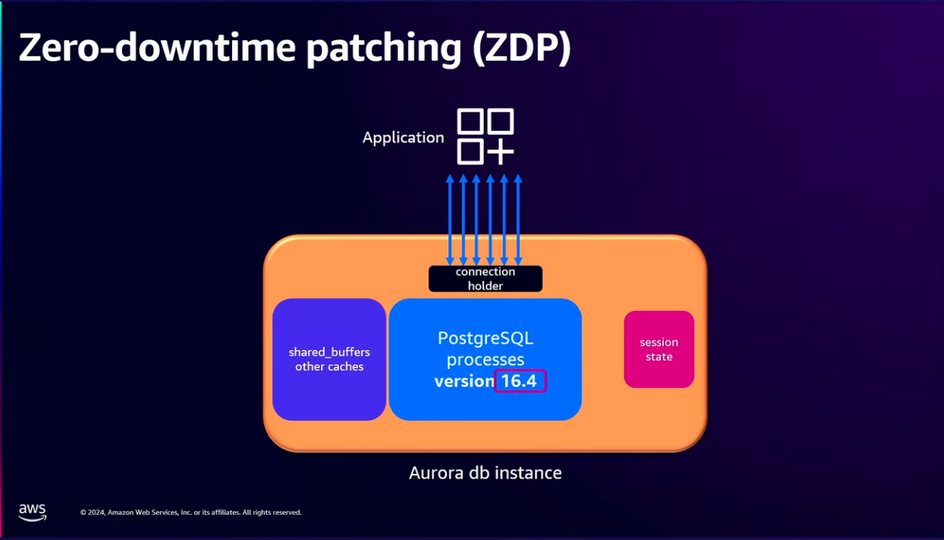

Slide 18
